Slide 1
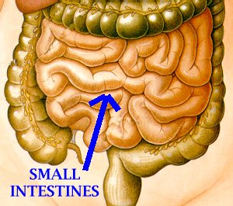
Intestinal flukes

Slide 2
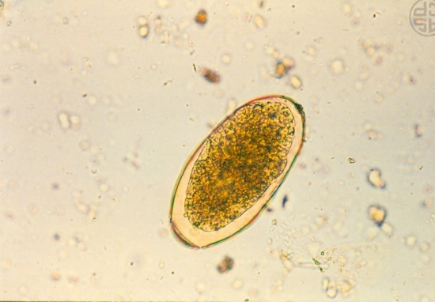
Fasciolopsis buski
Common name/ location: Giant intestinal fluke/ human small intestine, found in pigs as well
Epidemiology - Found in China, Taiwan, Vietnam, Thailand, Infection rate may be as high as 40%. It is the most common intestinal fluke in the orient.
Length: 25-75 mm
Disease: Fasiciolopsiasis
Diagnosis - Demonstrating eggs in feces specimens. Eggs are difficult to differentiate from those of Fasciola hepatica.

Slide 3
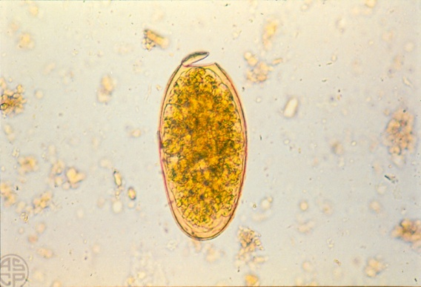
Morphology of eggs:
Oval, yellow-brown eggs measure 150 x 90 microns.
Operculum - the transparent shell has an operculum (sometimes seen “popped open”).
Major pathology - adult worms attach to the intestinal wall, producing local inflammation possibly leading to hemorrhage, ulceration and abscess formation. Absorption of worm metabolites can produce toxic or allergic reactions (edema, ascites).
Infective stage: Metacercaria
Intermediate host: 1- Snail Segmentin
2- Water chestnut
Diagnosis: Ova in feces (unemberyonated ova)

Slide 4
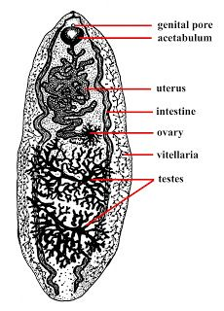
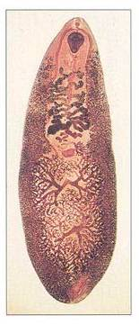
Fasciolopsis buski
Oral sucker
Ventral sucker
cecum
Uterus
ovary
Vitelline gland
Testes

Slide 5
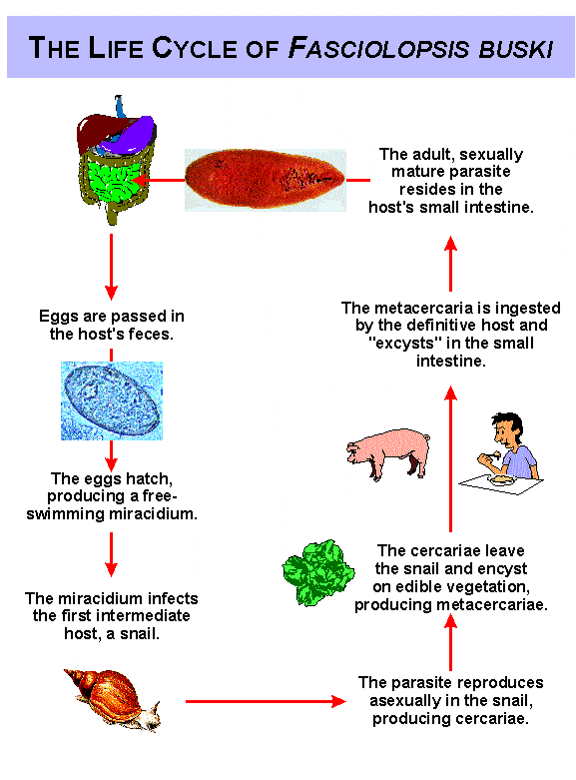

Slide 6
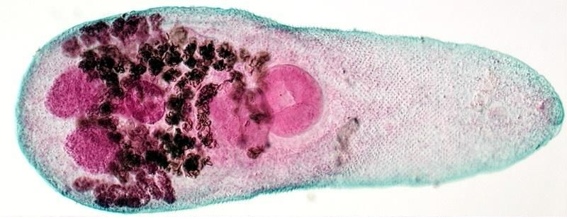
Heterophyes heterophyes
Common name/ location : Small intestine fluke/ live in small intestine between the villi of human/ other mammals that eating fish.
Length: 0.1 – 1.7 mm
Disease: Heterophyiasis
Infective stage: Metacercaria
Intermediate host: 1- Pirenella conica
2- Mugil

Slide 7
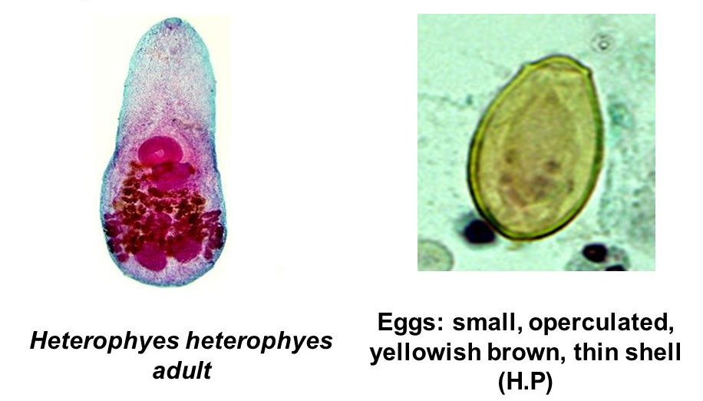
Pathology - Asymptomatic in light infections. Chronic mucous diarrhea and abdominal pain in heavy infections. Eggs may travel into tissue causing granulomas and other tissue disorders.
Diagnosis: ova in feces (Emberyonated )
Recovery and identification of eggs in feces.
Difficult to differentiate from each other and from C. sinensis unless adult worms are recovered.
A patient history is helpful since the infections are more common in one country or another. These are intestinal flukes, therefore, no liver involvement and symptoms would be expected.
Treatment is similar for all.

Slide 8
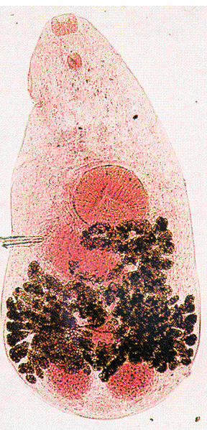
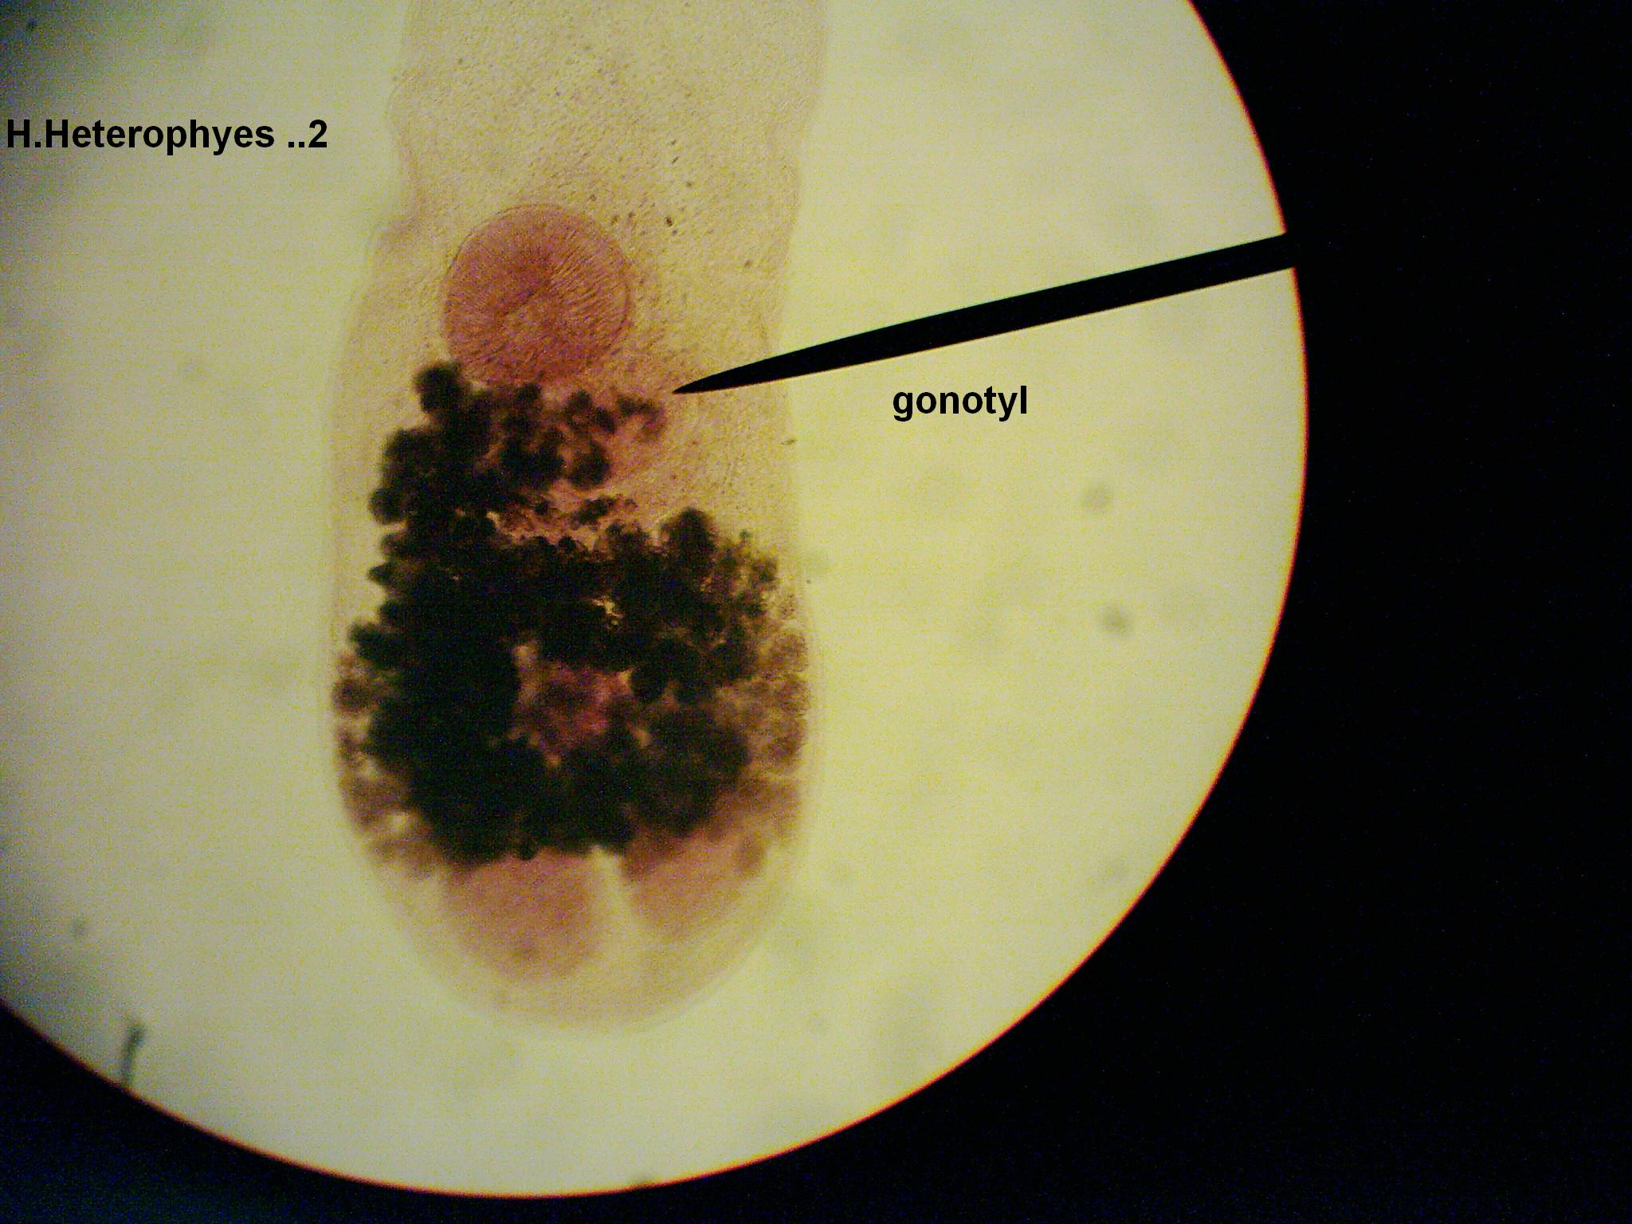
Heterophyes heterophyes
Oral sucker
Pharynx
Acetabulaum
Gonotyle
(Genital sucker)
Yolk glands
Ovary
Testes
Notes:
Genital sucker (gonotyle) to the posterior border of acetabulum

Slide 9
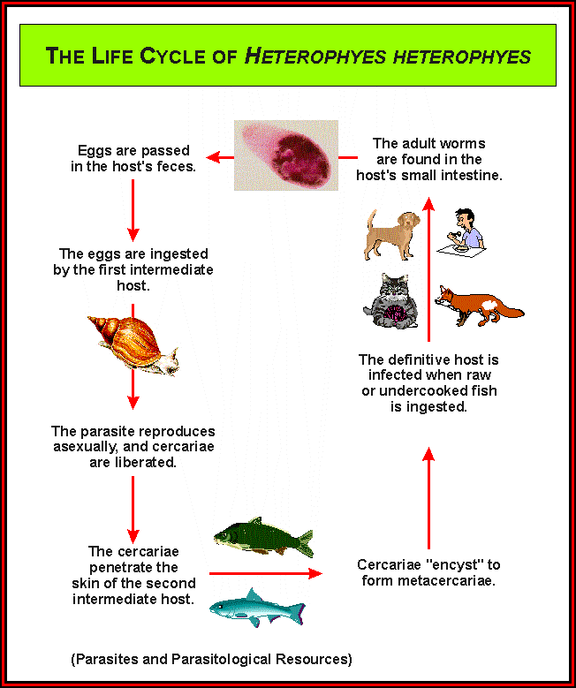

Slide 10
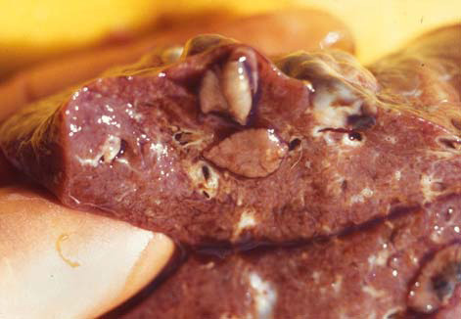
Lung flukes

Slide 11

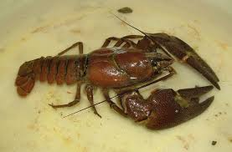
Paragonimus westermani
Common name/ Location: Oriental lung fluke , found in lungs of human
Length: 7.5 – 12 mm
Distribution: Far East, Central America, Africa, and India
Clinical disease: a chronic cough with bloody sputum, dyspnoa, pleuritic chest pain, and pneumonia.
Body: covered with scal-like spines
Disease: Paragonimiasis or pulmonary distomiasis
Prevention: cooking crabs and crayfish properly.
Infective stage: Metacercaria
Intermediate host: 1- Fresh water snail Thiara
2- crayfish
Diagnosis: Ova in sputum (sometimes in feces)

Slide 12
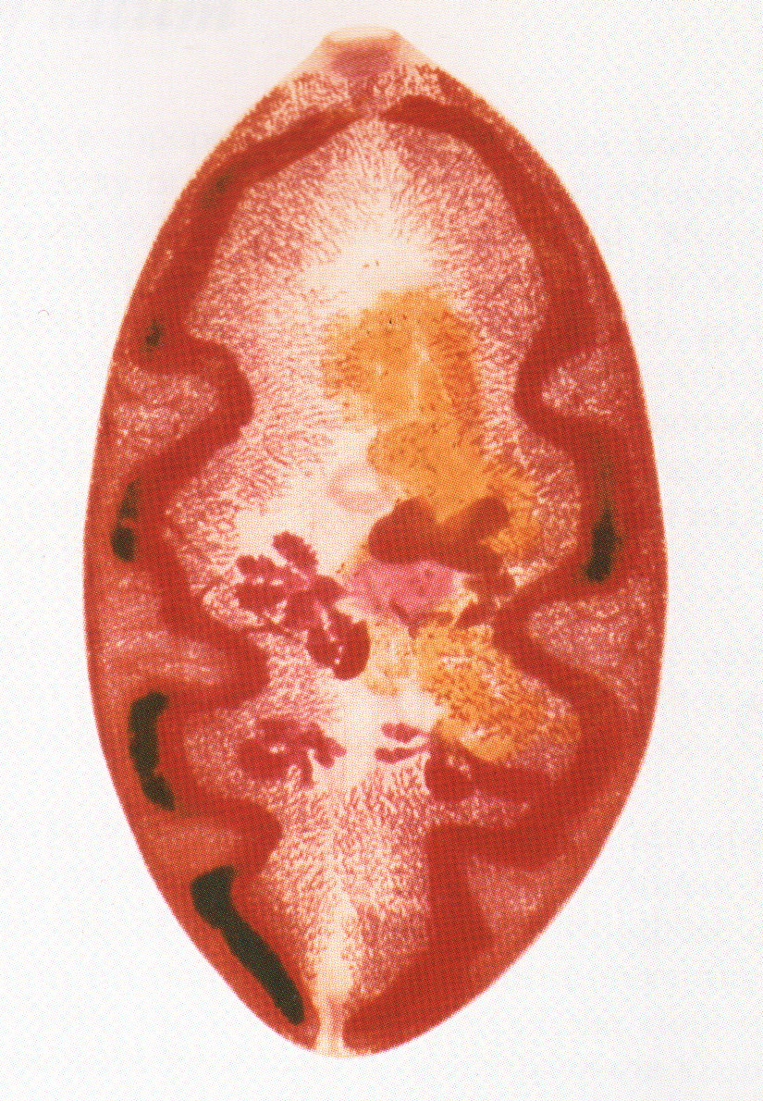
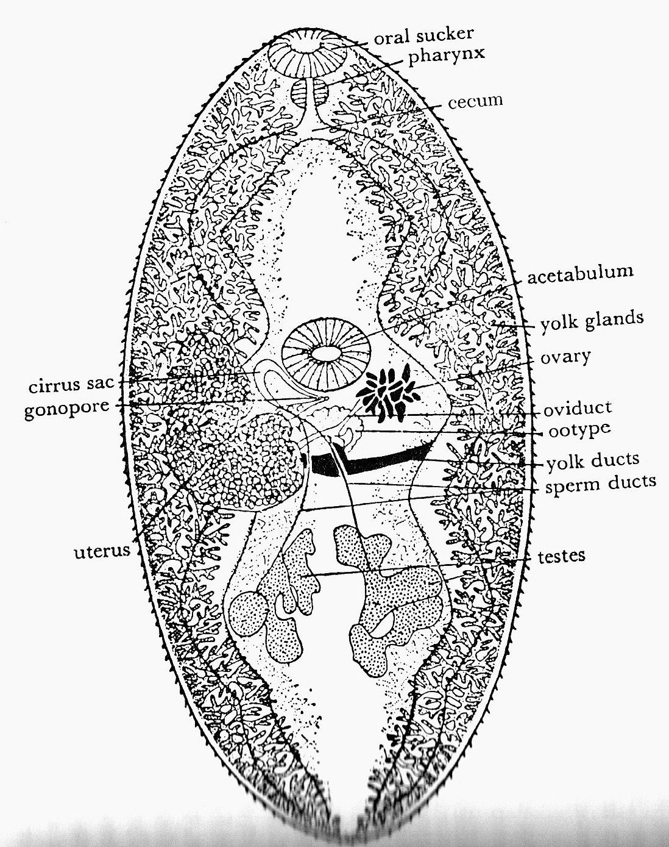
Paragonimus westermani
Oral sucker
Cecum
Ventral sucker
Uterus
Ootype
Ovary
Yolk gland
Testes

Slide 13
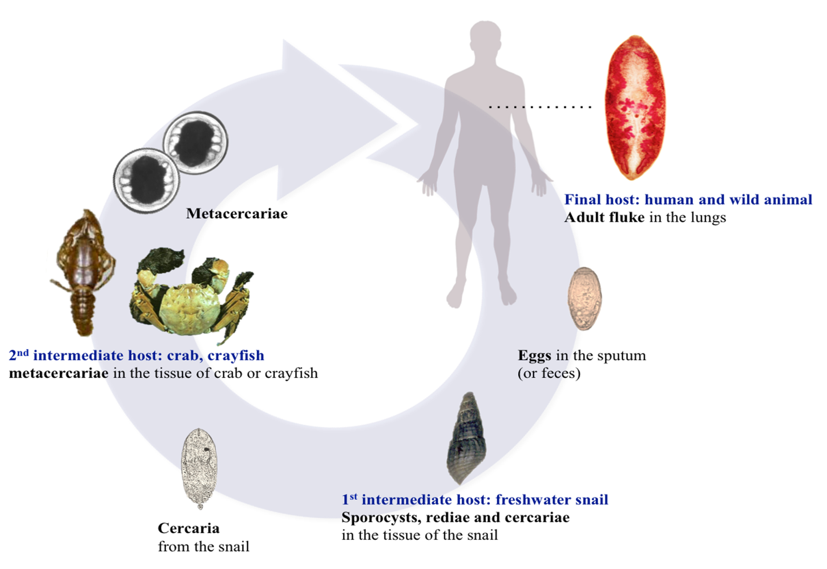
Paragonimus westermani life cycle

Slide 14
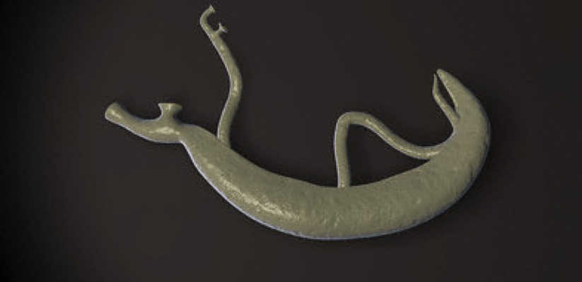
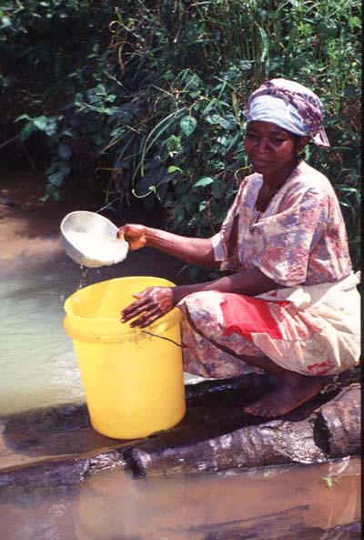
Schistosomiasis
المثقوبات الدموية (المنشقات)
Class: Trematoda
Blood Flukes

Slide 15
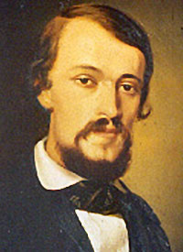
The German pathologist Theodor Bilharz was the first who described the adult Schistosoma worm in Egypt

Slide 16
Blood flukes (Schistosoma sp.)
S. haematobium - Africa and middle east
S. mansoni - Africa and Latin America
S. japonicum – Pacific region
Dioecious (male and female)
Schistosoma mansoni and Schistosoma japonicum cause Hepatosplenic Schistosomiasis.
Schistosoma haematobium causes Urinary Schistosomiasis.
Localization: venous vessels of bowel, liver, and bladder.
Morphology: atypical trematodes which the adult female nesting within a specialized groove in the body of the larger male.

Slide 17
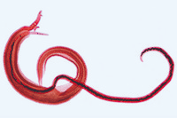
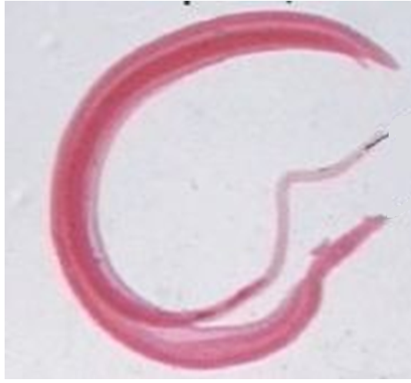
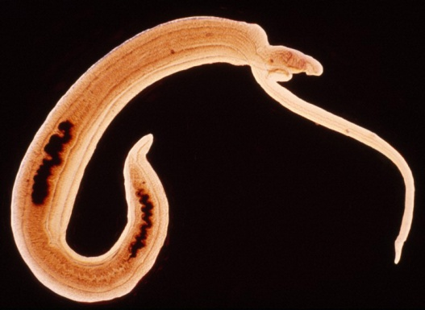
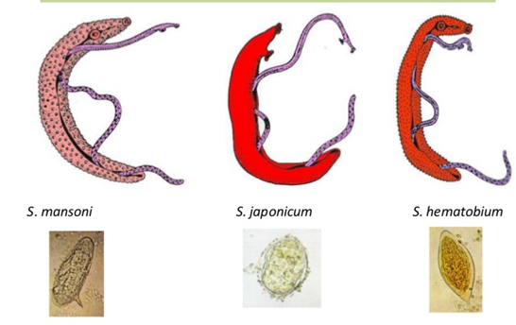

Slide 18
Schistosoma sp
Clinical manifestations of Hepatosplenic Shistosomiasis: eosinophilia, polyps in colon, fever, anorexia, weight loss, anemia, portal hypertension; cirrhosis of liver; pruritic skin rash. Eggs go back through portal circulation to liver, causing hepatomegaly, liver tenderness.
Clinical manifestations of Urinary Schistosomiasis: eosinophilia, hematuria, terminal dysuria (pain, difficulty at the end of urination); obstructed urine flow.

Slide 19
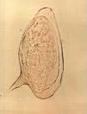
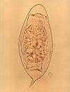
Schistosoma sp
Laboratory diagnostics of Hepatosplenic Schistosomiasis: eggs with lateral spine in feces
Laboratory diagnostics of Urinary Schistosomiasis: eggs with terminal spine in urine
Prevention: involves proper disposal of human waste and eradication of the snail host when possible. Swimming in endemic areas should be avoided.

Slide 20
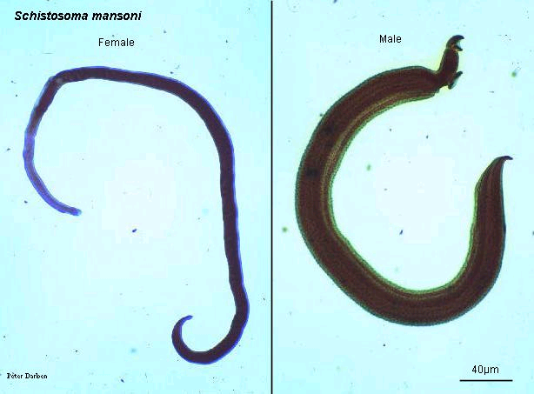
Blood flukes
Oral sucker: includes mouth
Ventral sucker: usually bigger than oral sucker and located near genital pore
Oral sucker
Ventral
sucker
Female
Male

Slide 21
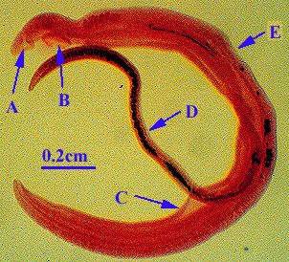
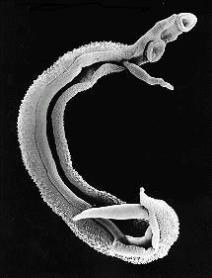
The body has a groove along mach of its length and, it was this groove that inspired the name Schistosoma or split body
The female lies within this groove, which is called gynaecophoric groove

Slide 22
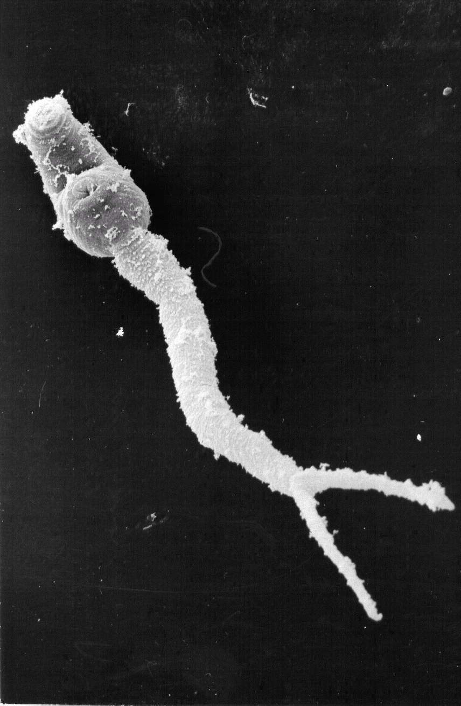
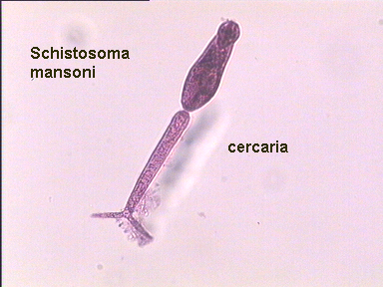
Cercaria of schistosoma spp is forked tailed cercaria
No redia in their life cycle stages

Slide 23
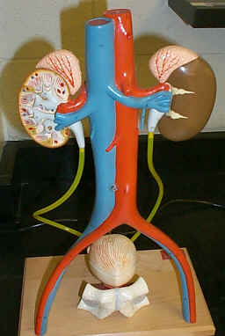
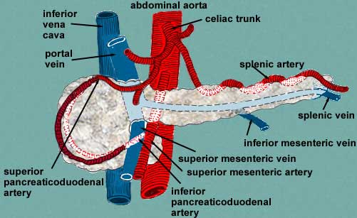
Site of infection
الأورده البوليه urinary veins والأورده المثانيه vesicle veins و الضفائر الحوضيه Pelvic plexus | S. haematobium
الأورده المساريقيه السفلى inferior mesenteric vein وفي الضفائر الباسوريه hemorrhoidal plexus | S. mansoni
الأورده المساريقيه العليا superior mesenteric vein قد توجد في الأورده المعديه المساريقيه gastric mesenteric veins | S. japonicum

Slide 24
Disease
Urinary bilharziasis بلهارزيا المجاري البوليه | Schistosoma haematobium
Intestinal Schistosomiasis داء المنشقات المعوي | Schistosoma mansoni
Oriantal Schistosomiasis داء المنشقات اليابانيه او داء المنشقات الشرقي | Schistosoma japonicum

Slide 25
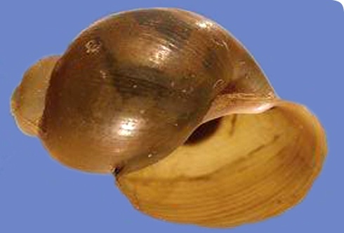
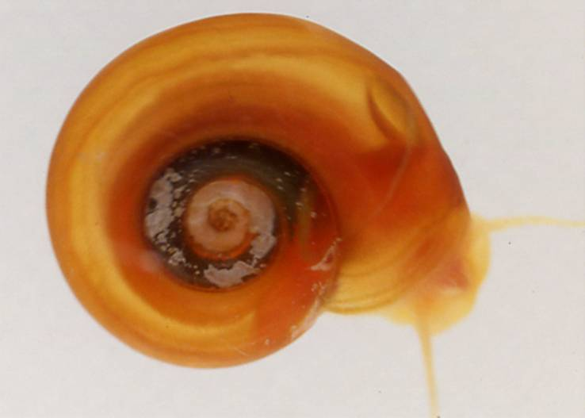
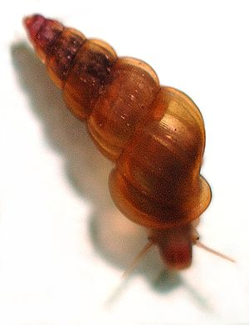
Intermediate hosts
Bulinus | S. haematobium
Biomphalaria | S. mansoni
Oncomelania | S. Japonicum

Slide 26
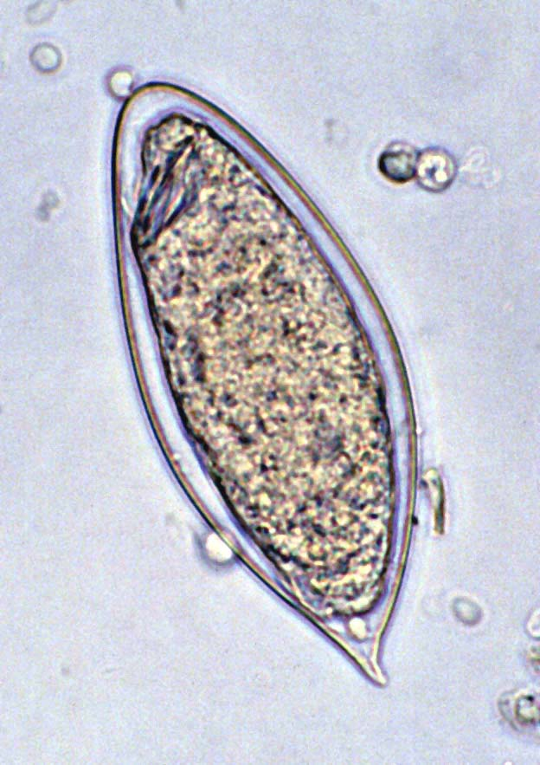
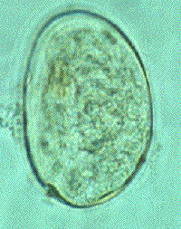
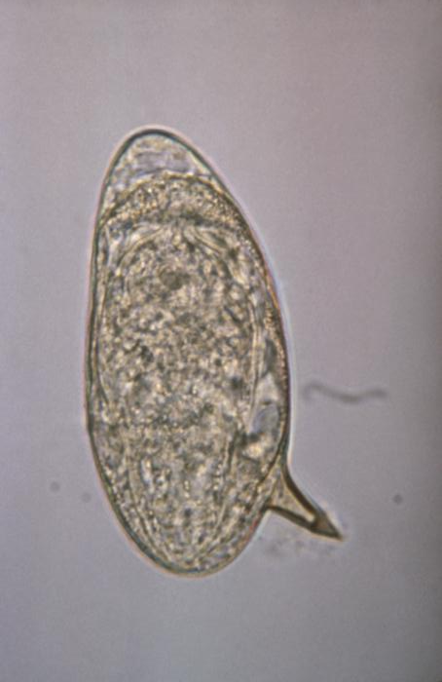
Blood flukes eggs (ova)
S. haematobium egg
big, with terminal spine,
Secreted with urine
S. mansoni egg
Bigger, with lateral spine,
Secreted with stool
S. japonicum egg
small, with reduces lateral spine (knob)
Secreted with stool

Slide 27
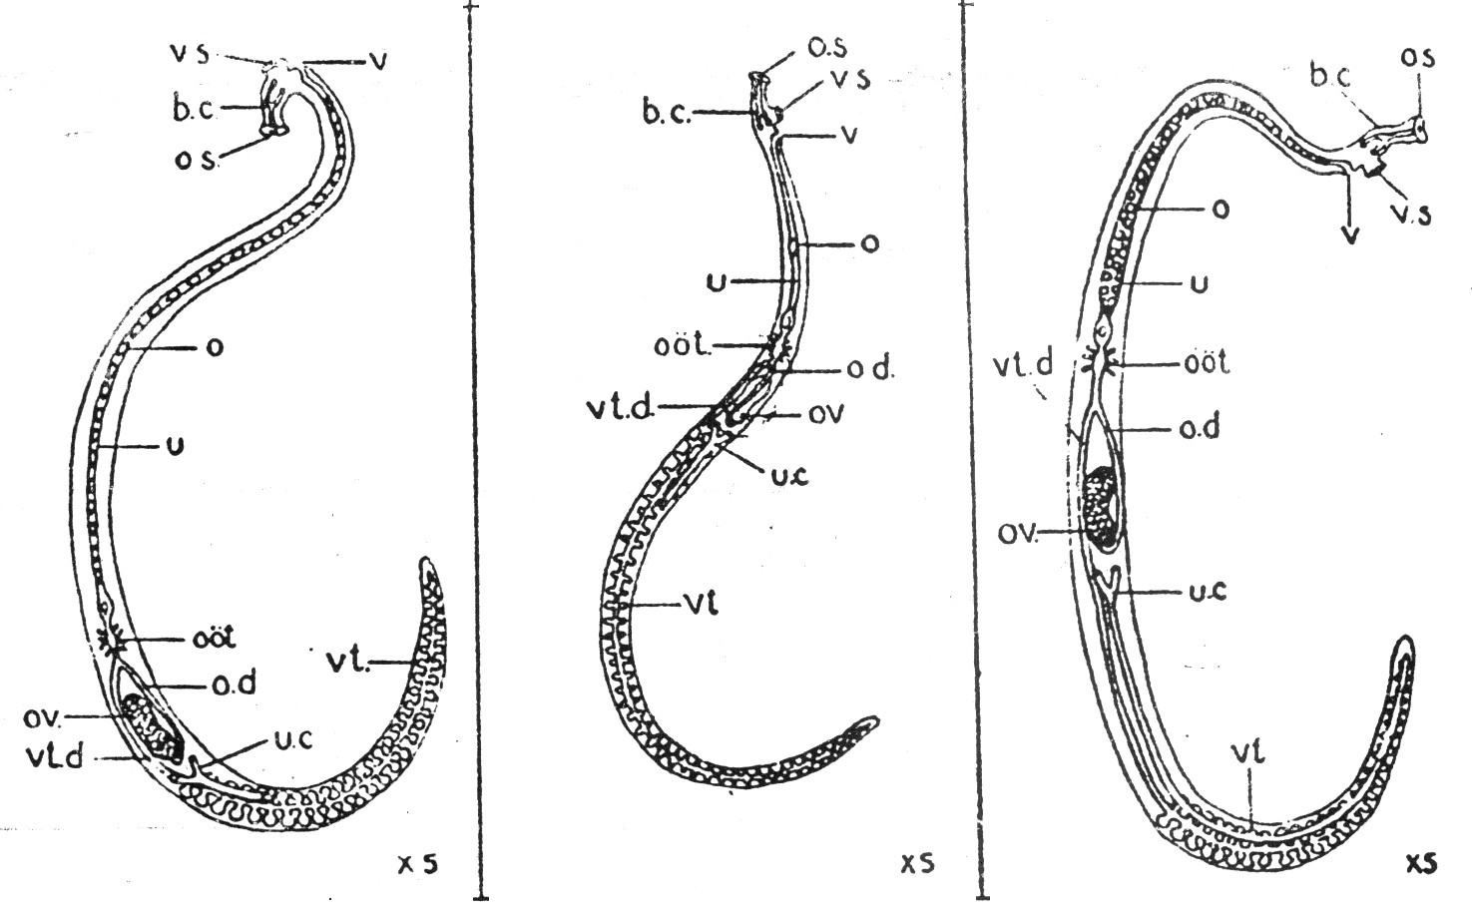
Female ovary and uterus location
S. japonicum | S. mansoni | S. haematobium
Middle of body | 1st half of body | 2nd half of body | Ovary
Long with 50-100 ova | Short with 1-4 ova | Long with 20-30 ova | Uterus

Slide 28
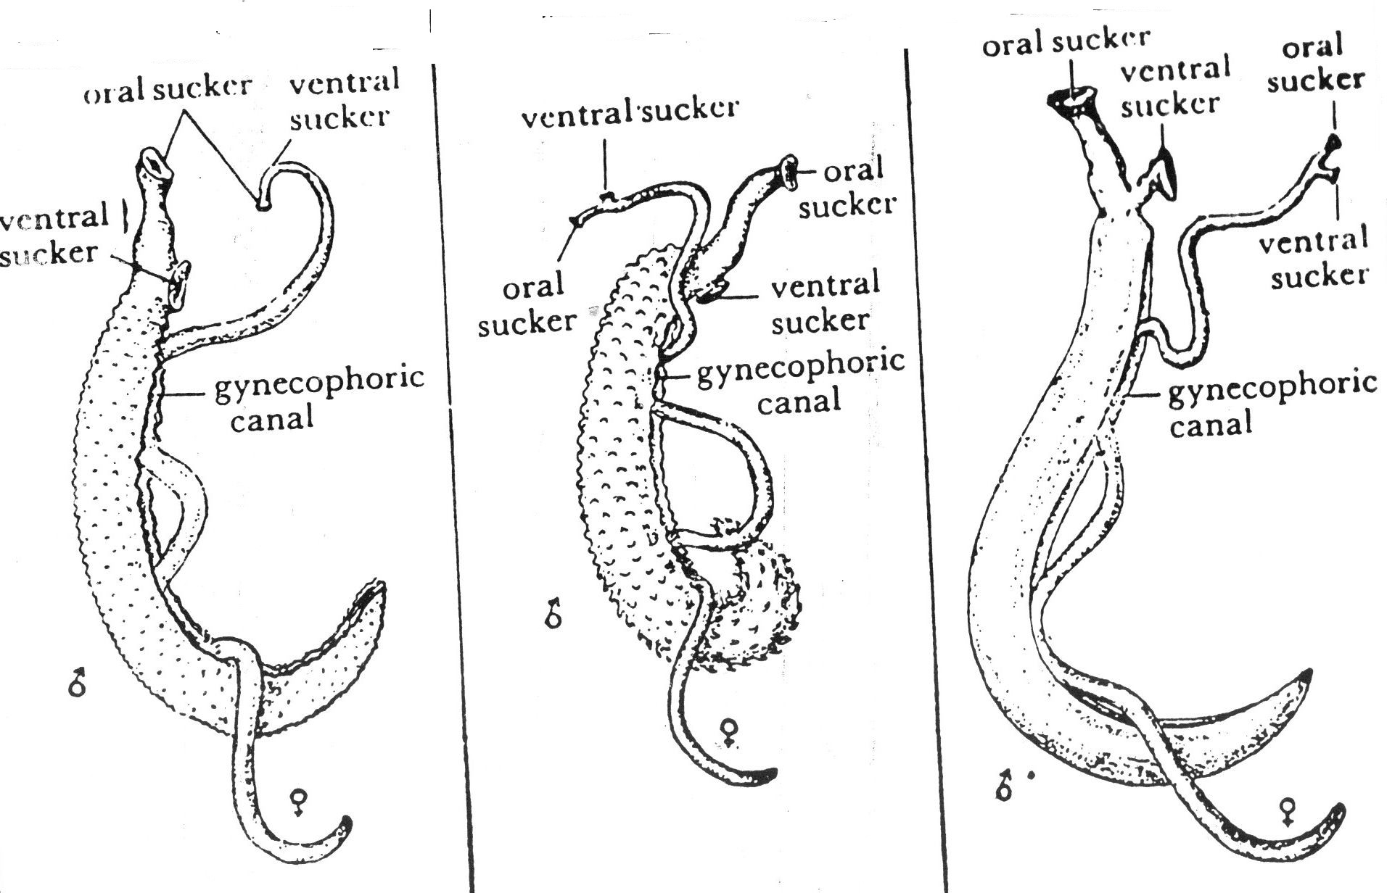
Male cuticula type and lenght
S. japonicum | S. mansoni | S. haematobium
Smooth cuticula | Cuticula with coarse tegument | Cuticula with fine tegument
12-20 mm | 6.5-9.9 mm | 10-15 mm

Slide 29
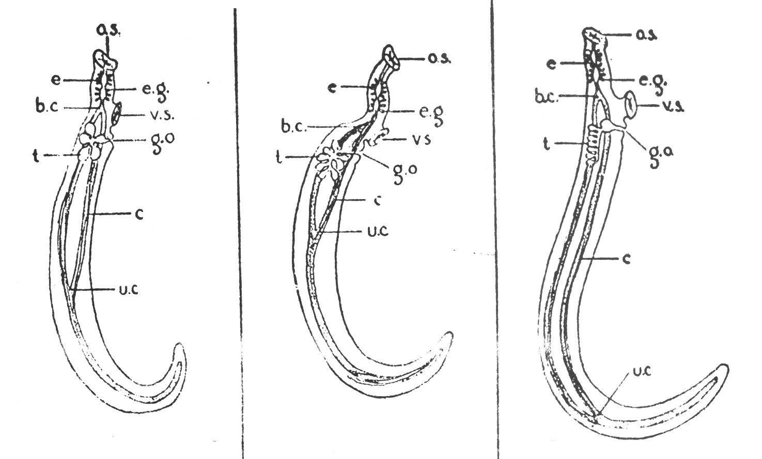
Male testes and intestine (ceca) junction
S.japonicum | S. mansoni | S. haematobium
3rd part of body | 1st part of body | 2nd part of body | Junction
Lined (6-8) | Small in cluster (6-9) | Big in cluster (4-5) | Testes

Slide 30
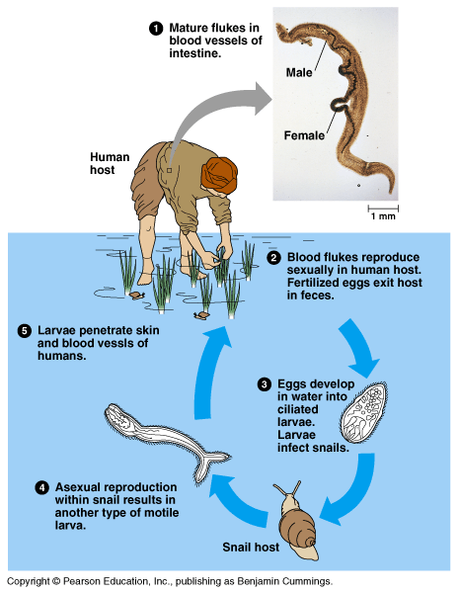
Life cycle of Schistosoma
Infective stage for human: cercariae.
Definitive host: man.
Intermediate host: snail.
Mode of transmission: penetration of skin by cercarie.

